Slide 1
Image Blur vs. Sharp Classification Using Traditional Neural Networks
Name: Asala Abu Grara & Sara Abu Mandil
Major: Data Science & Artificial Intelligence
University: University College of Applied Sciences
Course: Digital Image Processing

Slide 2
Problem Statement
Problem: Binary Image Classification
Sharp Images
Blurred Images
Motivation:
Blur reduces edge clarity and fine details
CNN models are computationally expensive
Our Approach:
Handcrafted spatial features
Multi-Layer Perceptron (MLP)

Slide 3
Neural Networks (Theoretical Part)
What is a Neural Network؟
Computational model inspired by biological neurons
Consists of interconnected layers
Learns patterns from data through weight updates
Main Components
Input Layer
Hidden Layer
Output Layer

Slide 4
Model Architecture (NN Design)
Multi-Layer Perceptron (MLP)
Input: Feature Vector
Hidden Layer: 50 neurons (ReLU)
Output Layer: 1 neuron (Sigmoid)
Loss Function
Binary Cross-Entropy
Optimizer
Adam
Final Model uses 3 features (after feature selection)
StandardScaler applied before MLP

Slide 5
Dataset
Kaggle Blur Dataset
Total: 1050 images
350 Sharp
350 Motion Blur
350 Defocus Blur
Binary Labels: Sharp → 0 Blurred → 1
Split: 80% Training 20% Testing

Slide 6
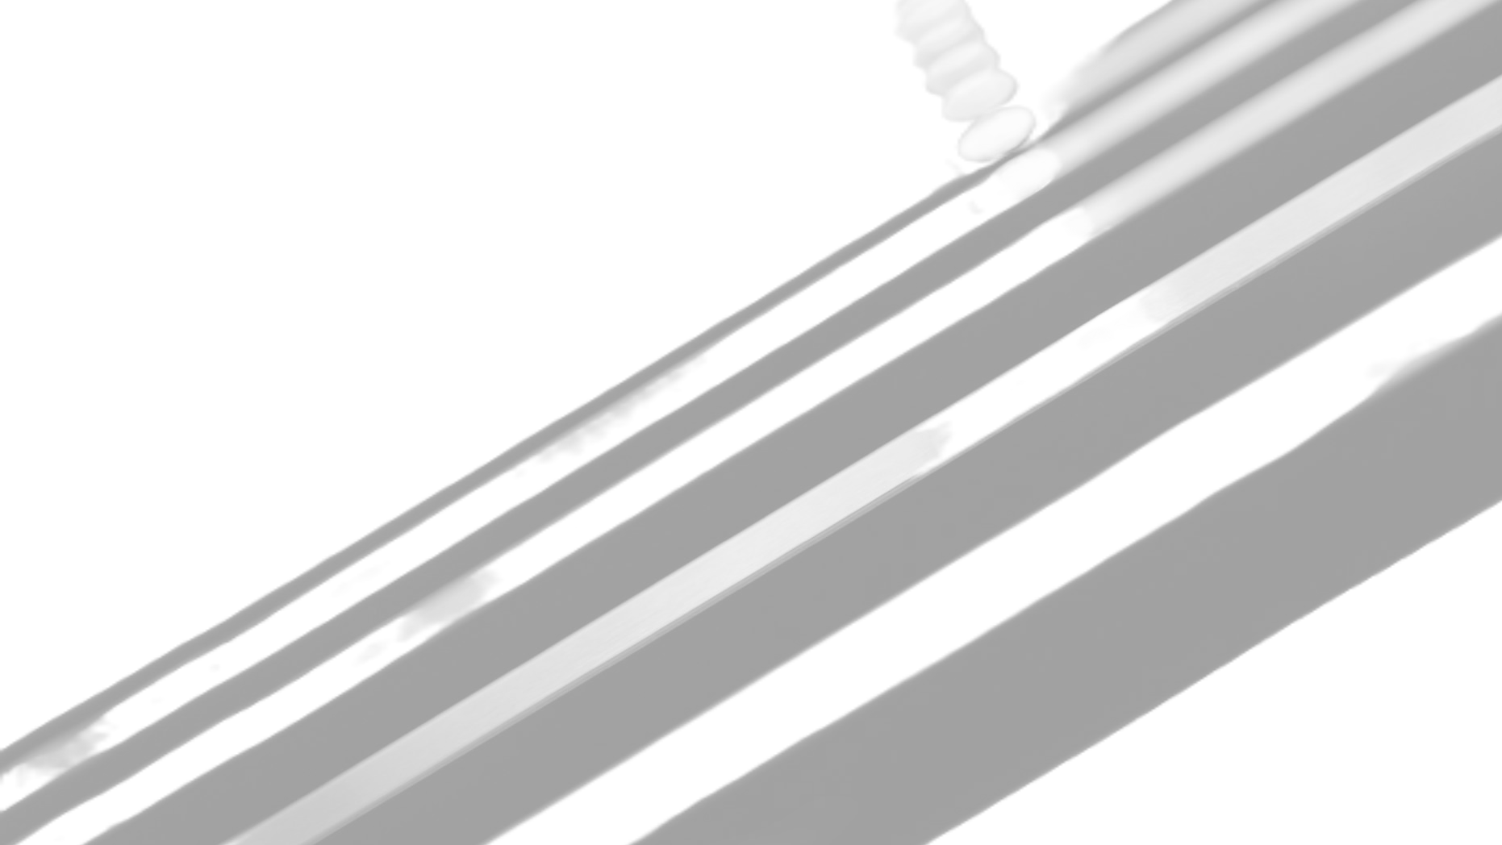
Feature Extraction
Extracted Spatial Features
Sobel X Variance (sobel_x_var)
Tenengrad
Sobel Magnitude Mean (sobel_mag_mean)
Laplacian Variance (removed in final model)
Why?
Blur reduces edge strength and gradient energy.

Slide 7
Training Method
Training Details
Hidden neurons tested: 10, 20, 50, 100
Best model: 50 neurons
Max iterations: 2000
Optimizer: Adam
Cross-validation applied on full dataset
Evaluation Metrics
Accuracy
Precision
Recall
F1-score
AUC

Slide 8
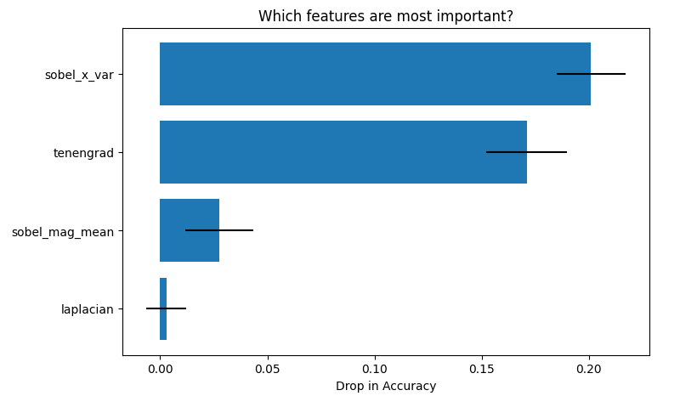
Experiments
Experiments Conducted
Architecture comparison
Feature importance analysis
Feature ablation study
Key Finding
Sobel X Variance → Most important
Tenengrad → Second most important
Laplacian → Least important (removed)

Slide 9
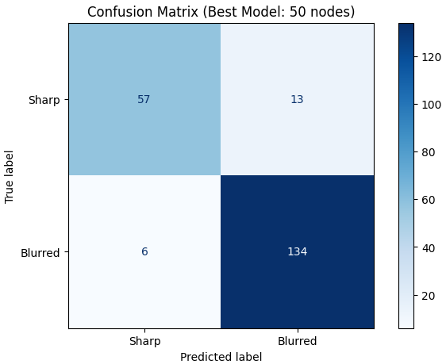
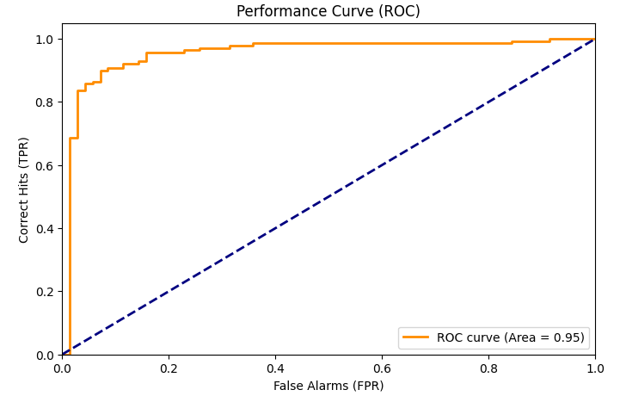
Results
Final Performance
Test Accuracy: 90.95%
Cross-Validation Accuracy: 92.19%
AUC ≈ 0.95
Confusion Matrix
True Negatives: 57
True Positives: 134
False Positives: 13
False Negatives: 6

Slide 10
Discussion
Observations
Strong performance using traditional NN
Stable cross-validation results
Efficient compared to CNNs
Low computational cost
Feature ablation confirmed that removing Laplacian did not reduce performance.
No signs of overfitting (train/test performance consistent)

Slide 11
Model Deployment & Web Application
Deployment
Web Interface
Users upload external images
System extracts features automatically
Real-time classification: Sharp / Blurred
Displays prediction with confidence score
Outcome
Model ready for real-world inference
Demonstrates practical applicability beyond experimentation
Final trained MLP model saved using Joblib
Feature list saved separately to ensure consistent input order
Preprocessing pipeline reused during inference

Slide 12
Conclusion & Demo
Conclusion
Traditional MLP performs effectively
Handcrafted features are discriminative
Suitable for lightweight real-time applications where CNNs are impractical
Now we will demonstrate the model on unseen images

